Slide 1
Operating Systems
SENS-3513
Week: 4
Process Management - 2
Operating System Concepts
9th edition
Silberschatz, Galvin & Gagne
John Wiley & Sons
2013
Dr Nauman Mazhar
Faculty of Information Technology (FIT)
University of Central Punjab (UCP)

Slide 2
Objectives
Process Management
(Programming in Linux)
Process Address Space
Process Creation in Linux
  fork(), exit(), wait() system calls
  getpid(), getppid(), waitpid()
  Process Tree
Process Invocation
  exec family of system calls
Orphan & Zombie Processes
2

Slide 3
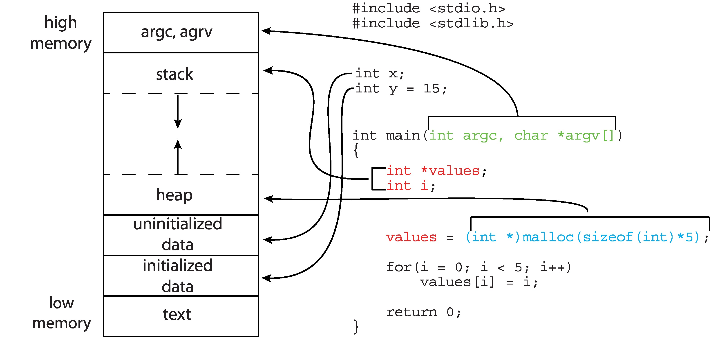
Process Address Space
3

Slide 4
Process Creation
OS frequently needs to create & terminate processes
When to create a process…?
  new user performs login
  user executes a shell command
  new application is launched
  to accomplish some tasks concurrently
  (web server may spawn new processes for each web request)
  a complex task may be decomposed into smaller ones, each handled by a separate process
  OS may create a process to perform a task on behalf of a user process (e.g, printing)
4

Slide 5
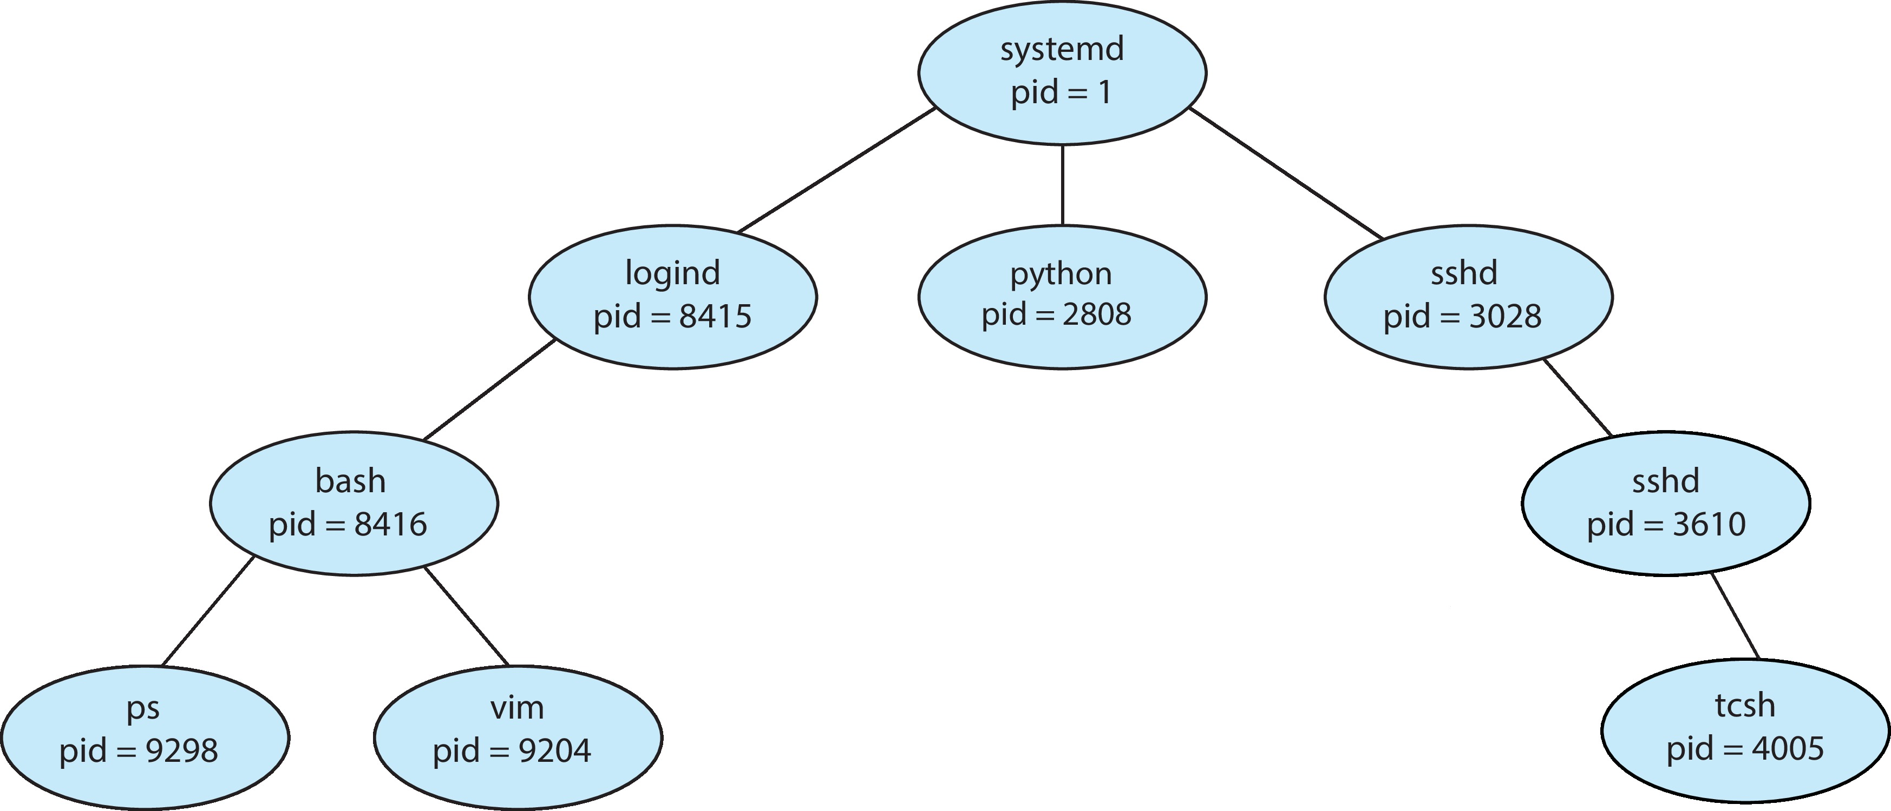
UNIX System - Process Tree
systemd, with PID = 1, is the first process started by kernel during system boot
5

Slide 6
Process Creation
If one process intends to launch a new process
  parent process → creates a child process
  child process → performs the intended task
  child process → may create another child, & so on
Steps taken by OS to create a child process…
  assign unique PID to new process
  Initialize a PCB
  allocate memory space → setup memory protection mech
  set appropriate linkages → pointer to program entry point
  setup file descriptor table → keep track of open files
  create or expand other data structures
6

Slide 7
Options - Process Creation
Options available when OS creates a child process…
Address space options
  child is duplicate of parent process (UNIX)
  child has a new program loaded in its address space
Resource sharing options
  parent & child share no resources
  parent & child share all resources
  child shares a subset of parent resources (UNIX)
Execution options
  parent waits, until child terminates
  parent & child execute concurrently (UNIX)
7

Slide 8
Process Creation in Unix
8

Slide 9
Process Creation – fork()
UNIX example
  fork() system call – used to create a child process
  parent & child have different PIDs
  child has its own separate address space – copy of parent
Return = PID of child
parent
parent
fork ()
child
Return = 0
9

Slide 10
Process Creation – fork()
//fork1.c
int main()
{
int cpid = fork();
if (cpid == 0) //child code
printf (“\n Hello I am child... \n”);
else //parent code
printf (“\n Hello I am parent... \n”);
}
10

Slide 11
Process Creation – fork()
fork() – allows parent process to create a child process
Called once, returns twice
  in parent → returns PID of child
  in child → returns zero
  on failure → returns -1 in parent, & sets errno
  no child process created
After fork() returns, both parent & child execute concurrently, from next line of code
pid_t fork();
Return = PID of child
parent
parent
fork ()
child
Return = 0
11

Slide 12
Process Creation – fork()
After successful fork()
  child process is clone of parent
  gets copy of parent → stack, heap, data, & text segments
  inherits all open file descriptors
  parent/child now free to execute on their own
  since data are different, program execution differs
Reasons for fork() failure
  not enough memory space
  max number of processes allowed on system has exceeded
  max number of processes allowed to execute under one user has exceeded
12

Slide 13
Example 1 - fork()
int main()
{
int cpid = fork();
if (cpid == -1)
{
printf (“\n Fork failed \n”); exit (1);
}
if (cpid == 0) //child code
{
printf (“\n Hello I am child \n”);
}
else //parent code
{
printf (“\n Hello I am parent \n”);
}
}
What will be the sequence of execution of parent & child…?
13

Slide 14
Question !!
What will be the output of the code ?
Output- 1
Hello I am child
Hello I am parent
Output- 2
Hello I am parent
Hello I am child
OR
If child executes first : Output-1
If parent executes first : Output-2
14

Slide 15
PID & PPID
Each process is identified by a positive integer, unique on the system – PID
  systemd is the first user-space process with PID 1,
  manages system initialization, services, & daemons
Process ID obtained by using getpid(), getppid()
  returns PID, PPID of current process;
  never fail
Shell cmds for PID & PPID of shell:
echo $$ echo $PPID
Parent of any process can be found by looking at 4th field of /proc/PID/stat file
  3rd field shows state of process (R,S,T,Z)
pid_t getpid();
pid_t getppid();
15

Slide 16
Example 2 - fork()
parent / child execute concurrently.
What will be the output…!!
int main(){
int cpid = fork();
if (cpid == 0)
while(1)
putchar('x');
else
while(1)
putc('o', stdout);
return 0;
}
16

Slide 17
Example 3 - fork()
int main(){
int cpid = fork();
if (cpid == 0)
printf("child here.\n");
else
printf("parent here.\n");
printf("who is here.\n");
return 0;
}
What will be the output…!!
17

Slide 18
Example 4 - fork()
/*Child inherits copy of variables of parent*/
int gvar = 555;
int main(){
int lvar = 54;
int cpid = fork();
if (cpid == 0)
printf ("Child process PID = %ld, gvar = %d, lvar = %d \n", (long)getpid(),gvar,lvar);
else
printf ("Parent process PID = %ld, gvar = %d, lvar = %d \n", (long)getpid(),gvar,lvar);
return 0;
}
18

Slide 19
Example 5 - fork()
/* Both parent / child have their own copy of variables*/
int main(){
int i, cpid, ctr = 0;
cpid = fork();
if (cpid == 0){
ctr = 100;
for (i = 0; i< 3; i++)
printf ("Child counter: %d\n", ctr++); }
else{
for(i = 0; i< 3; i++)
printf ("Parent counter: %d\n", ctr++);
}
return 0;
}
19

Slide 20
Example 6 - fork()
/* What happens when fork() called multiple times*/
int main(){
fork();
fork();
fork();
printf("Hello fork...\n");
return 0;
}
20

Slide 21
Example 7 - fork()
/* What happens when fork() called multiple times*/
int main(int argc, char *argv[]){
if(argc != 2){
printf("Must enter one int argument\n"); exit(1);
}
int n = atoi(argv[1]);
int i;
for (i=1; i <= n; i++)
fork();
printf(“UCP \n");
exit(0);
}
21

Slide 22
Example 8 - fork()
/* What happens when fork() called multiple times*/
int main(){
fork() && fork();
fprintf(stderr, "%s\n",“UCP");
return 0;
}
results in a total of 3 processes in the system…!!!
22

Slide 23
Example 8 - explanation
First fork() creates a child process
  this makes two processes available, parent P and child C1
In both P and C1, the && operator is evaluated
  for right side of && to be executed, left side must be true
  fork() returns child PID in P, and 0 in C1
  so, the left side is true in P and false in C1
In P, second fork() is executed, which creates another child C2
In C1, first fork() was false, and right side of && is not executed
  C1 doesn't create another child
Results in total of 3 processes: P, C1 & C2
23

Slide 24
Example 9 - fork()
/* What happens when fork() called multiple times*/
int main(){
fork() && fork() || fork();
fprintf(stderr, "%s\n",“UCP");
return 0;
}
The && operator has higher precedence than ||
( fork() && fork() ) || fork();
Total of 5 processes in the system…!!!
24

Slide 25
Process Termination
25

Slide 26
Process Termination – exit()
System Call – exit ( int status )
Process terminates by calling exit()
  performs resource cleanup for terminating process
  memory released, open file descriptors closed
  graceful termination
Also allows child to return exit status code to parent
  status code used as argument to exit() – integer value
  status code tells parent about success or failure of child execution
      status code 0 → success
      non-zero value → error conditions
26

Slide 27
Passing exit status code
Parent process can call wait() to obtain exit status of child
When child terminates, exit status code returned to parent process
parent process
wait()
parent continues
parent
pid = fork()
exit()
child process
27

Slide 28
wait() System Call
  Parent calls wait()
    returns PID of child
      -1 on error
  Serves two purposes:
      notifies parent that child execution ends
      tells parent how child finished → exit status
  Parent calls wait() & blocks till any of its child terminates
    on termination, child returns status via → exit (status)
      parent receives value in status argument → wait (status)
    Can check exit status of the last command in shell (echo $?)
pid_t wait (int* status);
28

Slide 29
Example - fork() & wait()
int main(){
int cpid = fork();
if (cpid == 0){
printf("Hello I am Child\n");
printf("Child again, and my PID is: %ld\n", getpid());
printf("Child again, and I am terminating...\n");
exit(7);
}else{
int rv, status;
rv = wait( &status );
printf ("Hello I am Parent\n");
printf("Return value of wait() is: %ld \n",rv);
printf("Child exit status: %d\n", WEXITSTATUS(status));
exit(54);
} }
29

Slide 30
Example - fork() & wait()
$ ./a.out
Hello I am Child
Child again, and my PID is: 6867
Child again, and I am terminating...
Hello I am Parent
Return value of wait is: 6867
Child exit status: 7
$ echo $?
54
30

Slide 31
Child Termination
Parent may terminate execution of one of its children for
variety of reasons:
  task assigned to child no longer required
  child exceeded allocated resources (memory, execution time)
  parent reached max children limit
Cascading termination
  termination initiated by OS, if :
    parent is exiting, &
    OS does not allow child to continue if parent terminates
  all children, grandchildren, etc, terminated
  Unix allows child to continue execution
  even if parent terminates – orphan process
31

Slide 32
Process Termination
Processes may terminate due to following reasons:
  Normal completion
  Memory unavailable
  Protection error
  Mathematical error
  I/O failure
  Operator intervention
  Cascading termination (by OS)
32

Slide 33
Processes - Orphans & Zombies
33

Slide 34
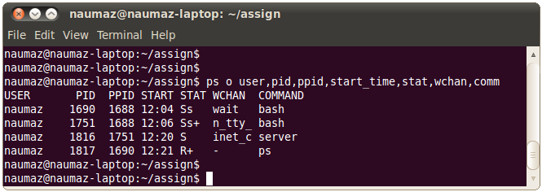
Process Related Shell Command
Command | Description
# ps [auxl] | Display status of processes
34
Notes:
-a: displays information about the processes executing on your terminal except the session leader (your login shell)
-e: display info about all the processes running on the system
-l: display long list (14 columns) of the status report
-u uidlist: display info about processes belonging toe the users with the UIDs in comma separated uidlist
State : I, R, S, T U, Z
Daemon is a system process running in the back ground, e.g., lpd, fingerd, inetd,
The primary purpose of kill command is to send a signal / software interrupt to a process.
Commonly used signal numbers:
-1: Hang up signal is generated when you log out
-2: Interrupt signal is generate when you press CTRL + C
-3: Quit signal is generated when you press CTRL-\
-9: Sure kill
-15: Software signal ( default signal number)

Slide 35
Process States
Common process states seen using ‘ps’ command:
R (Running) : currently executing
S (Sleeping) : blocked or waiting,
for an event or resource (I/O, timer, etc)
D (Disk Sleep) : in uninterruptible sleep, can’t be awakened
waiting for disk / device driver response
T (Stopped) : suspended or halted,
can be resumed or terminated
Z (Zombie) : terminated, but not fully removed from system
waiting for parent to acknowledge termination
X (Dead) : terminated, & being removed from system
35

Slide 36
Orphan Process
  Orphan – child still running but parent terminates
  orphan process adopted by systemd – collects exit status
int main(){
int cpid = fork();
if (cpid == 0){
printf("Running child, PID = %ld PPID = %ld\n",
(long)getpid(), (long)getppid());
while(1);
}
else
printf("Terminating parent, PID = %ld PPID = %ld\n",
(long)getpid(), (long)getppid());
exit(0);
}
36

Slide 37
Zombie Process
  Zombie
    child terminated, but parent didn’t collect exit status
    wait() not called – child not reaped
    process still holds resources – PCB, few OS tables
    but not scheduled on CPU
    half-alive & half-dead
  Zombie needs to be killed / removed from system…
    not killed by signals – even SIGKILL
    only way is to → kill the parent process…
      child becomes orphan
      adopted by systemd
      and then reaped
37

Slide 38
Zombie Process
int main(){
int cpid = fork();
if (cpid == 0){
printf("Terminating child with PID = %ld\n",
(long)getpid());
exit (0);
}
else{
printf("Running parent, PID=%ld\n",(long)getpid());
while(1);
}
}
  Parent has to use wait() to reap child process, & clear zombies
38

Slide 39
Process Invocation
39

Slide 40
Main uses of fork()
When process wants to Duplicate itself
(parent & child need to execute different sections of
the same code, concurrently)
  Example: Consider a network Server…
  parent waits for service request from client
  when request arrives, parent calls fork()
  child process → handles the request
  parent process → goes back to listen for next request
When process wants to execute a New program
right after fork() returns, child calls exec()
(also used for shell commands)
40

Slide 41
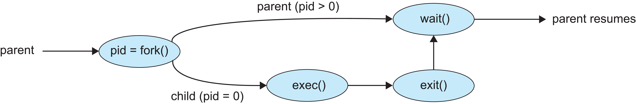
Executing new Program
  fork() by parent, creates child process
  exec() by child, immediately after fork()
  replaces child memory space with new executable
  wait() by parent, allows parent to wait for child termination
  & get exit status
41

Slide 42
Executing new Program – exec()
  execve() system call used to load a new program into memory space of calling process
    replace current program image with new one
    new program starts execution from its main function
  exec() family has five library functions layered upon execve()
    provide different ways to pass arguments to new program
    many interfaces to same functionality
  There is no return after successful exec() call
    if error → return value -1
    errno set to indicate error
42

Slide 43
exec() family - Library Functions
Five library functions for exec()
  library wrappers built on execve() system call
Function | Syntax
execve() (system call) | int execve (const char *pathname, char *const argv[], char *const envp[]);
execl() | int execl (const char *path, const char *arg0, ..., (char *)NULL);
execv() | int execv (const char *path, char *const argv[]);
execlp() | int execlp (const char *file, const char *arg0, ..., (char *)NULL);
execvp() | int execvp (const char *file, char *const argv[]);
execle() | int execle (const char *path, const char *arg0, ..., (char *)NULL, char *const envp[]);
43

Slide 44
exec() family - Library Functions
Difference between the library functions
  whether need to search thru PATH environment variable, &
  use list, or array args
Function | Search PATH? | Args Type | Description
execl() | No | List | Pass arguments as a list
execv() | No | Array | Pass arguments as an array (vector)
execlp() | Yes | List | Like execl(), but searches PATH
execvp() | Yes | Array | Like execv(), but searches PATH
execle() | No | List + env | Pass a custom environment array
44

Slide 45
Example 1- fork() & execl()
int main(){
int cpid = fork();
if (cpid == 0){
execl("/bin/ls", "-l", "/home/", NULL);
printf("This line will not be printed\n");
}
else{
wait(NULL);
printf("Hello I m Parent.\n");
}
return 0;
}
45

Slide 46
Example 2 - fork() & execl()
int main(){
int cpid = fork();
if (cpid == 0){
execl("/usr/bin/gnome-calculator",NULL);
printf("This line will not be printed\n");
}
else{
wait(NULL);
printf("Hello I m Parent.\n");
}
return 0;
}
46

Slide 47
exec() family - Library Functions
1. execl()
int execl(const char *path, const char *arg0, ...,(char *)NULL);
execl("/bin/ls", "ls", "-l", "/home", (char *)NULL);
2. execv()
int execv(const char *path, char *const argv[]);
char *args[] = {"ls", "-l", "/home", NULL};
execv("/bin/ls", args);
47

Slide 48
exec() family - Library Functions
3. execlp()
int execlp(const char *file, const char *arg0, ..., (char *)NULL);
execlp("ls", "ls", "-l", (char *)NULL);
4. execvp()
int execvp(const char *file, char *const argv[]);
char *args[] = {"ls", "-l", NULL};
execvp("ls", args);
48

Slide 49
exec() family - Library Functions
5. execle()
int execle(const char *path,
const char *arg0, ..., (char *)NULL,
char *const envp[]);
char *env[] = {"PATH=/usr/bin", "USER=test", NULL};
execle("/bin/ls", "ls", "-l", "/home", (char *)NULL, env);
49

